Slide 1




Module: Advanced Agent Competition - [PJ] Künstliche Intelligenz in Robocup
Human - Robot Collaboration and Teamwork “in Smart Urban Factory towards Industry 4.0”
Perspective taking (Theory of Mind) and adaptive decision-making in HRI
Qichao Xu 378485 qcxumib@gmail.com
Gazelle Zaheer 362681 gazelle.zaheer@gmail.com
Maximilian Thorand 330099 m.thorand@gmx.de
MILESTONE 3 Presentation

Slide 2

AAC: Human Robot Collaboration and Teamwork in Smart Urban Factory
Agenda
Motivation
Problem definition
Architecture
MDP/POMDP model
Demo
(if time left: Challenges)

Slide 3
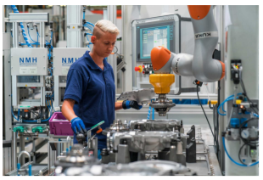
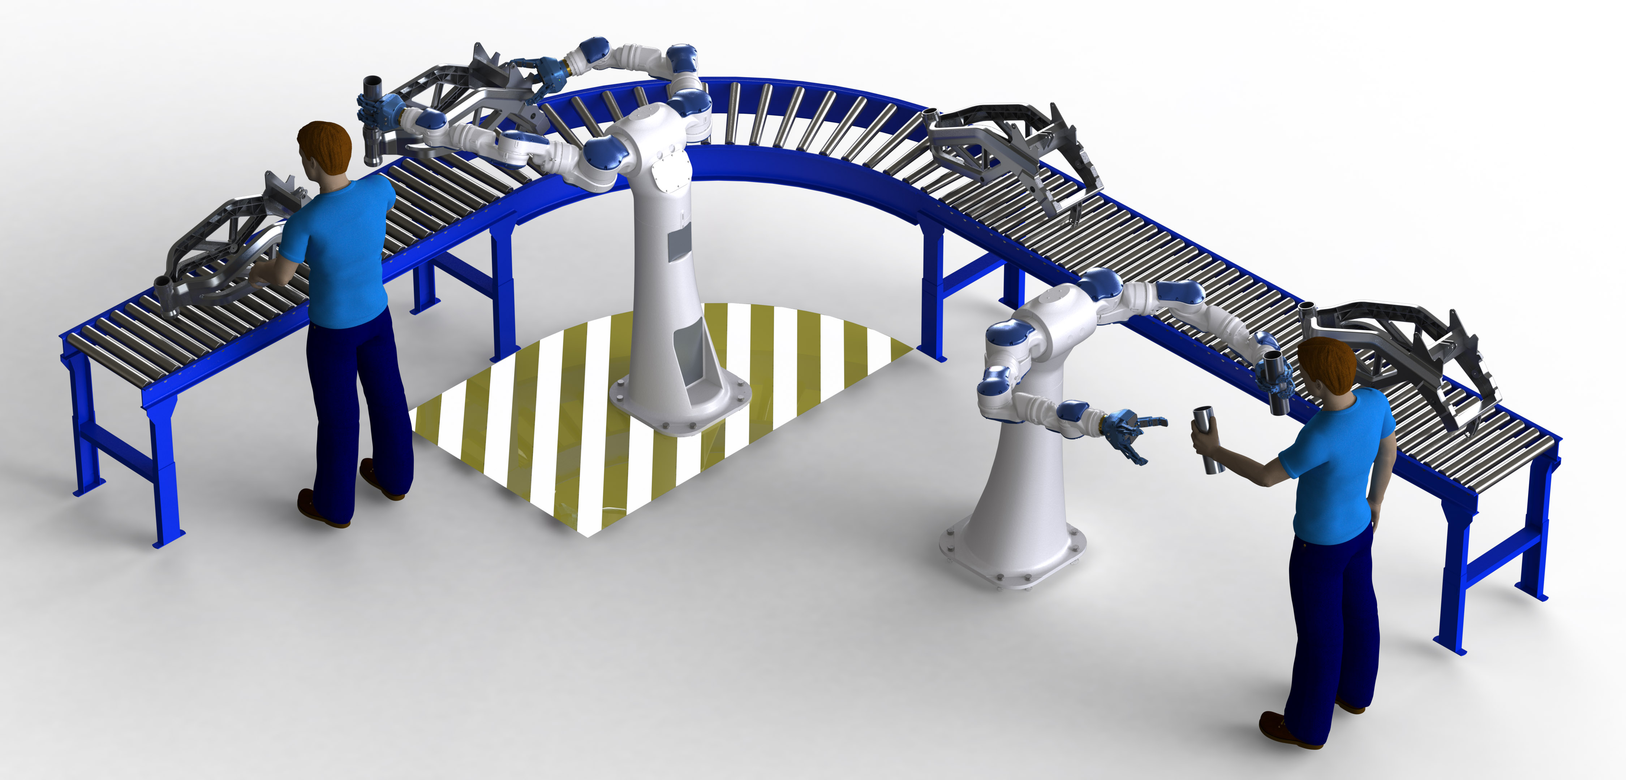
AAC: Human Robot Collaboration and Teamwork in Smart Urban Factory
Motivation
Human-Robot-Collaboration biggest part in Industry 4.0
Human will be replaced more and more with robots in industrial production
Advantages Robot: precise, fast, monotonous, repetitive work
Human-Robot-Collaboration is a future branch
3

Slide 4
AAC: Human Robot Collaboration and Teamwork in Smart Urban Factory
Problem definition
Development of an interface to generate decisions according to the object parameters
Animating and Modelling Human, Robot using MORSE
Defining states and actions for Human using MDP (Markov Decision Process)
Robot decision making and collaboration with Human using POMDP (Partially Observable Markov Decision Process)
3
4

Slide 5
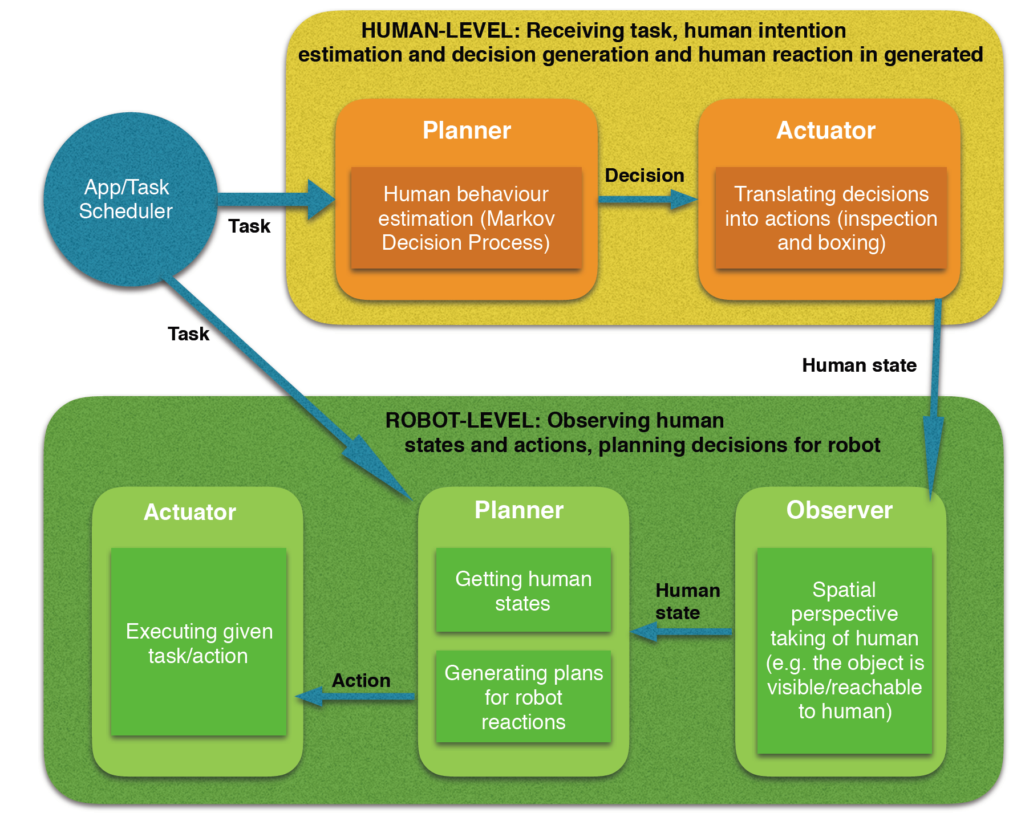
AAC: Human Robot Collaboration and Teamwork in Smart Urban Factory
General architecture
3
4

Slide 6
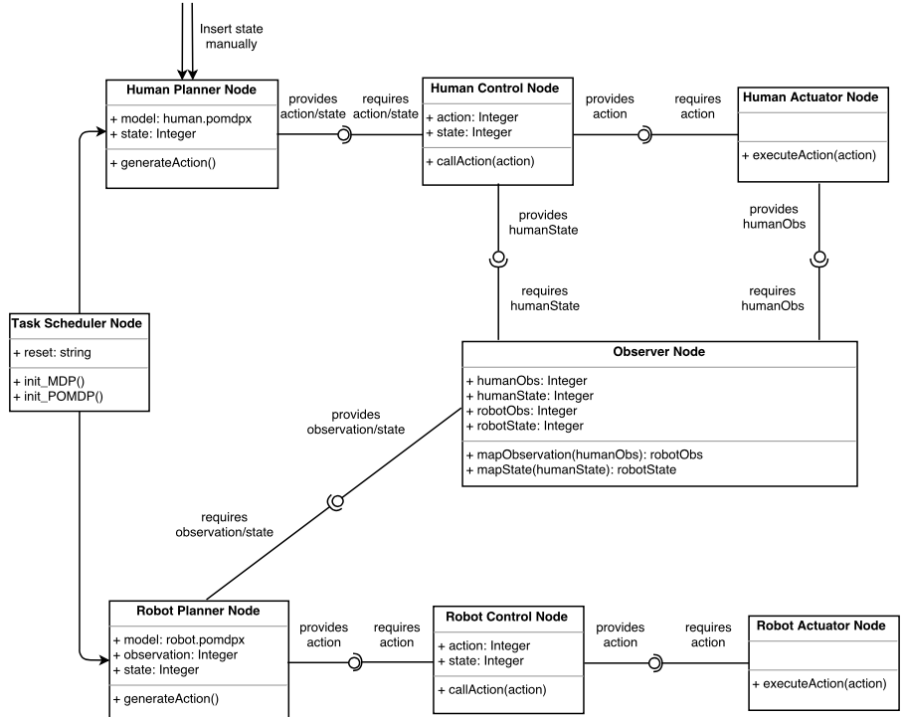
AAC: Human Robot Collaboration and Teamwork in Smart Urban Factory
Detailed Architecture
3
4

Slide 7
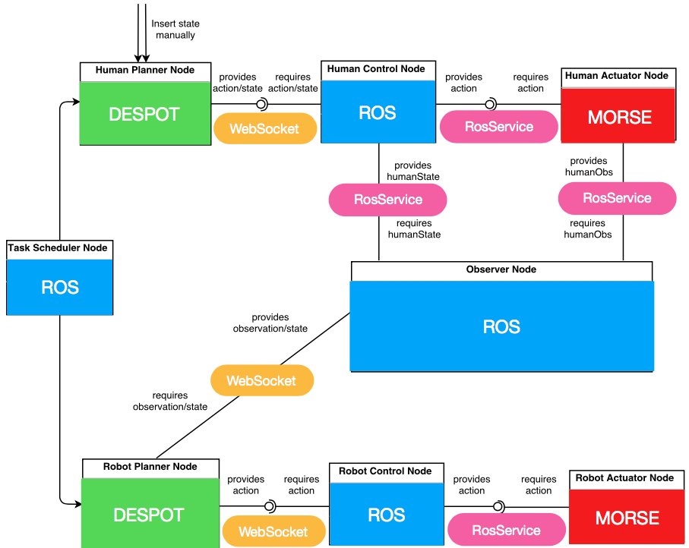
AAC: Human Robot Collaboration and Teamwork in Smart Urban Factory
Solution Approach
3
4

Slide 8
Human Modelling - Semi-Autonomous
S0
S1
S2
S3
S4
S5
S6
S7
States
Task
Assigned
Success
Failed
To Grasp
No
Attention
Evaluating
Tired
Rest
Warn
Robot
1
S0
2
3
S0
S0
5
S0
n
S3
S5
S4
S3
S4
S3
S5
S4
S7
S5
S1
S2
S6
S1
S2
S1
S2

Slide 9
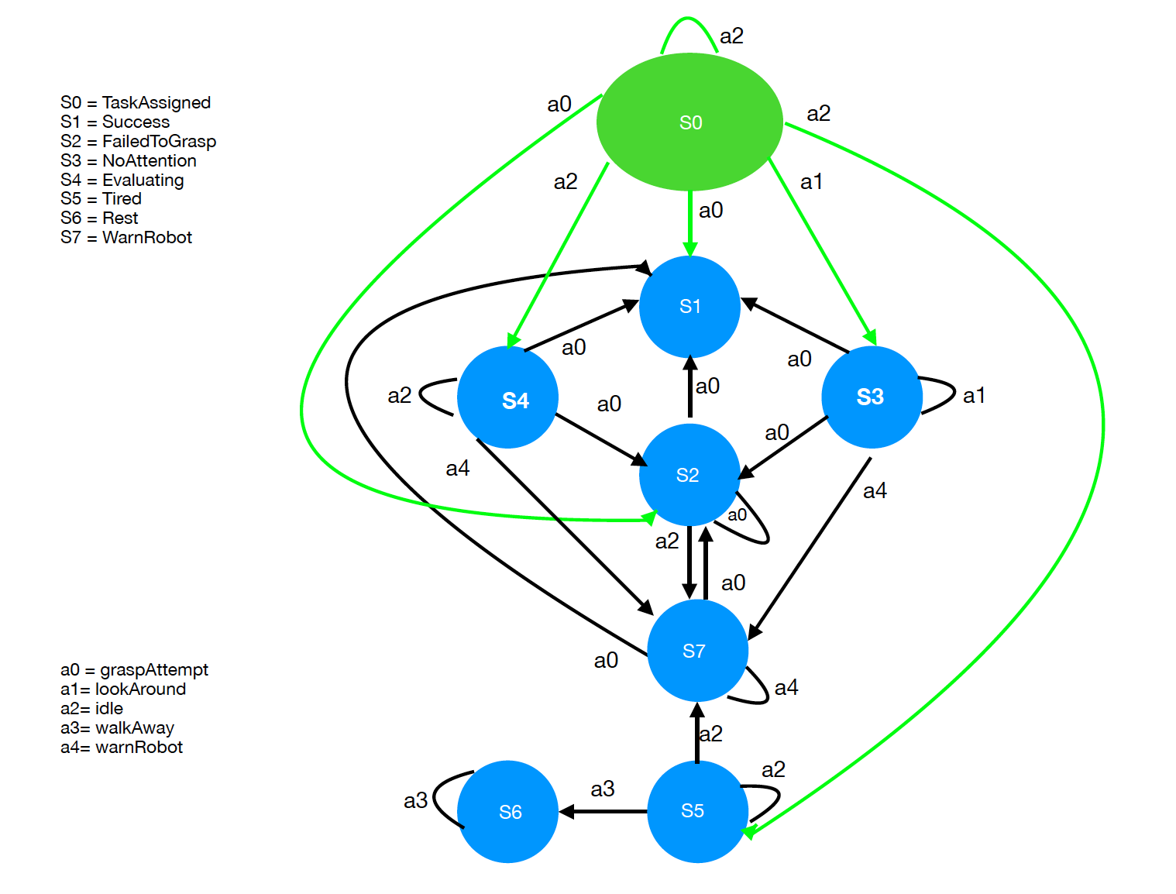
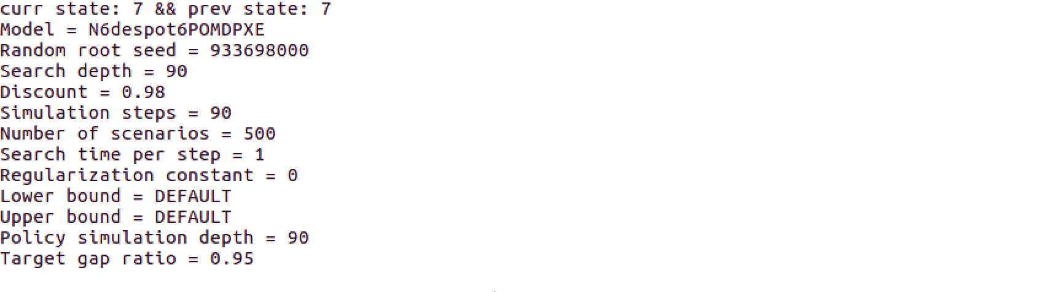
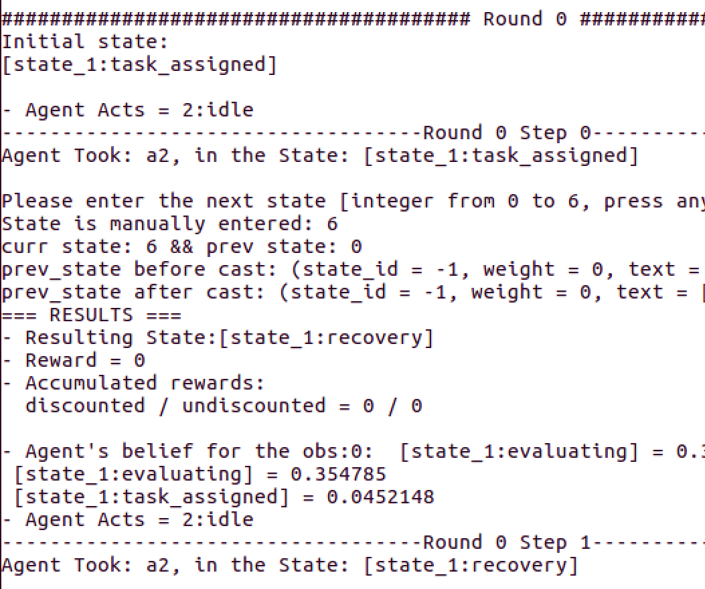
AAC: Human Robot Collaboration and Teamwork in Smart Urban Factory
Human Modelling - Fully Autonomous
1
2
3
4
5
3
4

Slide 10
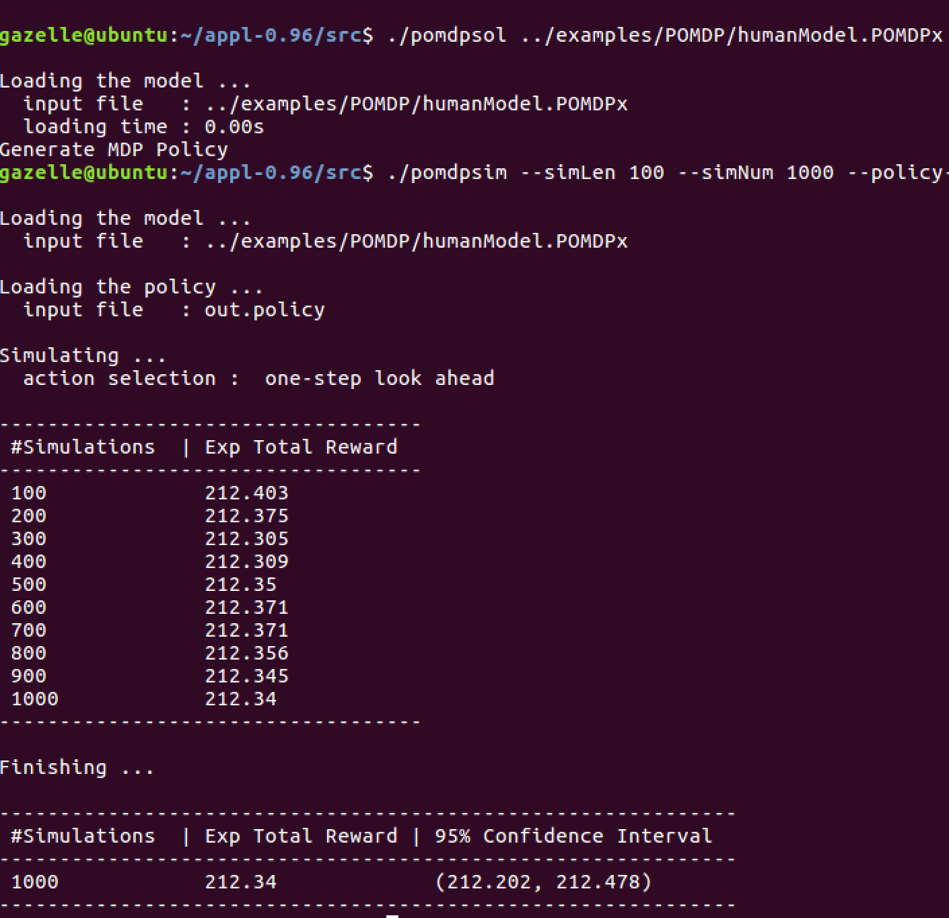
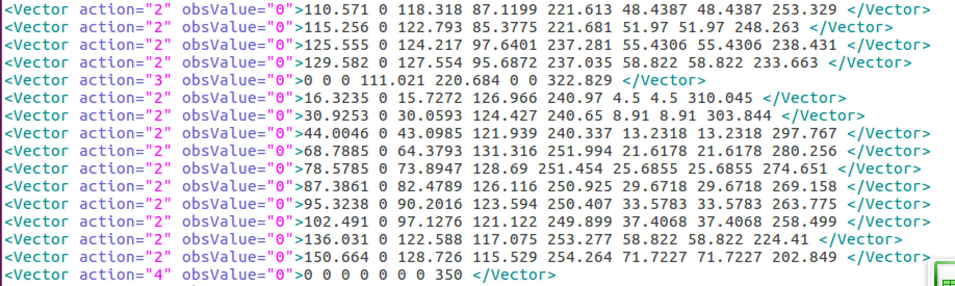
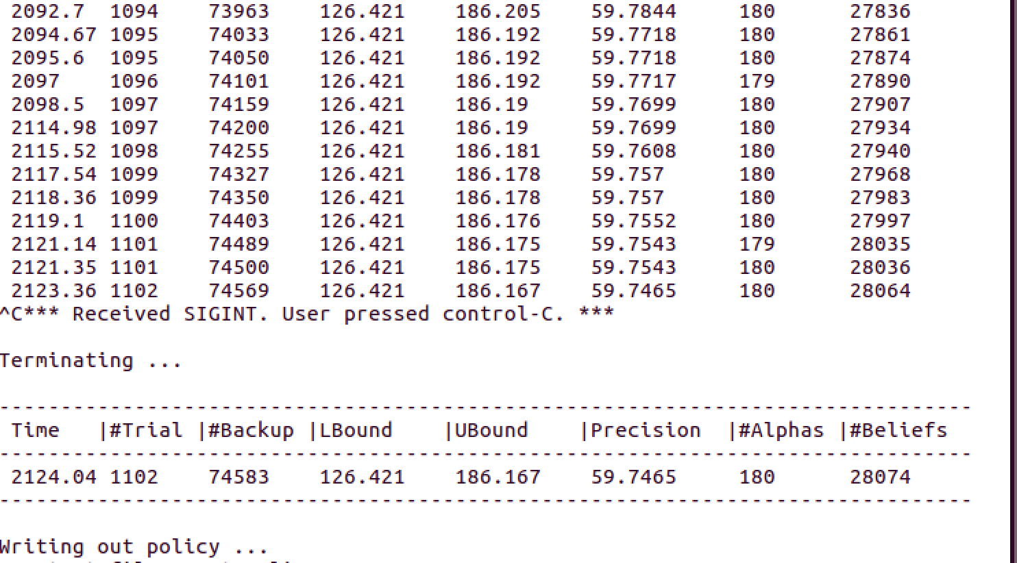
AAC: Human Robot Collaboration and Teamwork in Smart Urban Factory
Human Modelling - Fully Autonomous
Policy
Solving Time
Simulations
3
4

Slide 11
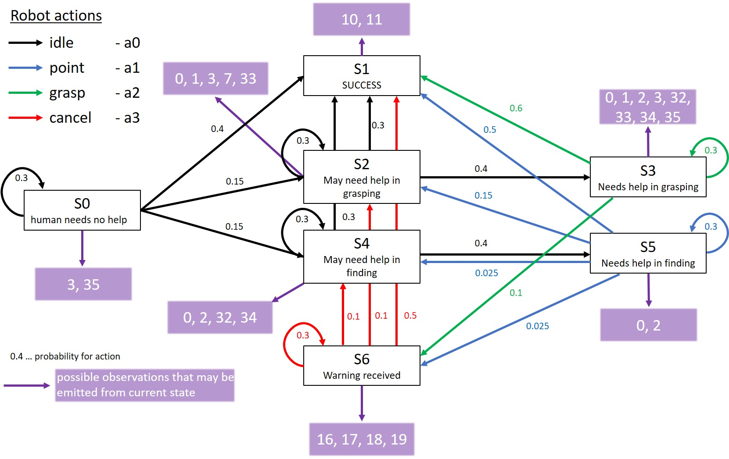
AAC: Human Robot Collaboration and Teamwork in Smart Urban Factory
Robot Modeling - POMDP
3
4

Slide 12
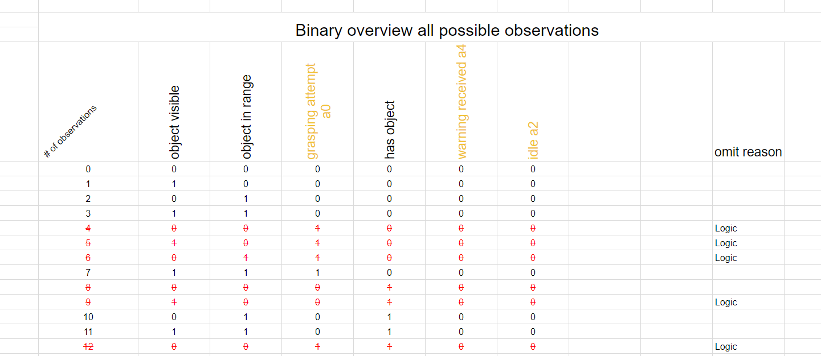
AAC: Human Robot Collaboration and Teamwork in Smart Urban Factory
Binary Overview of Observations
=2^m
3
4

Slide 13
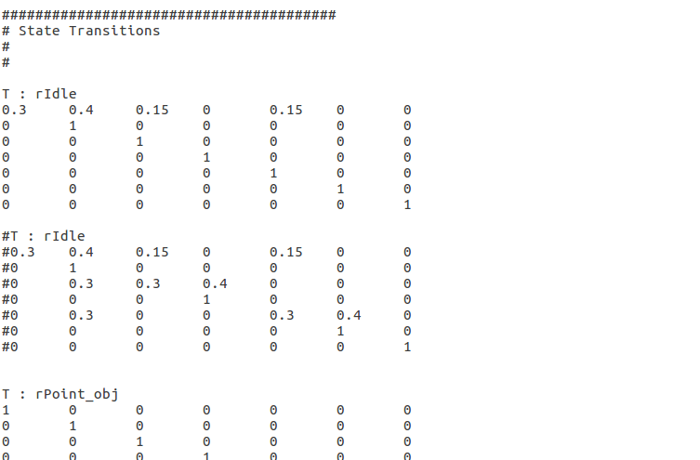
AAC: Human Robot Collaboration and Teamwork in Smart Urban Factory
POMDP Example: Different state transitions and their visualization
Graph
3
4

Slide 14
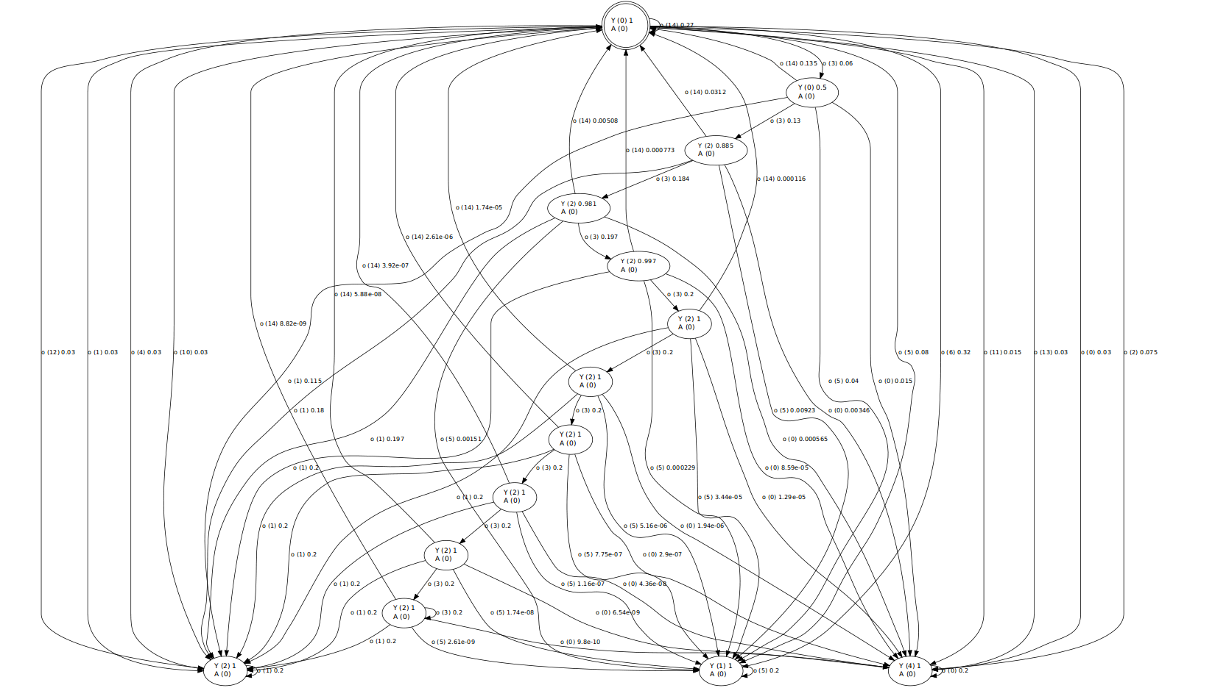
AAC: Human Robot Collaboration and Teamwork in Smart Urban Factory
Human Modeling - MDP
3
4

Slide 15
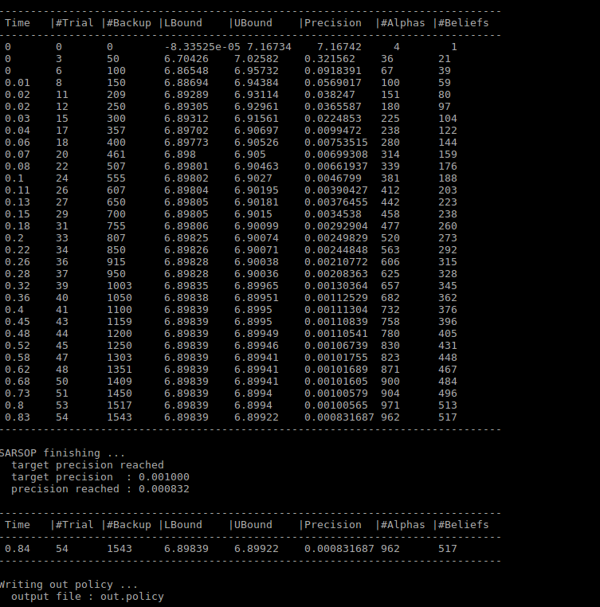
AAC: Human Robot Collaboration and Teamwork in Smart Urban Factory
Human Modeling - MDP
3
4

Slide 16
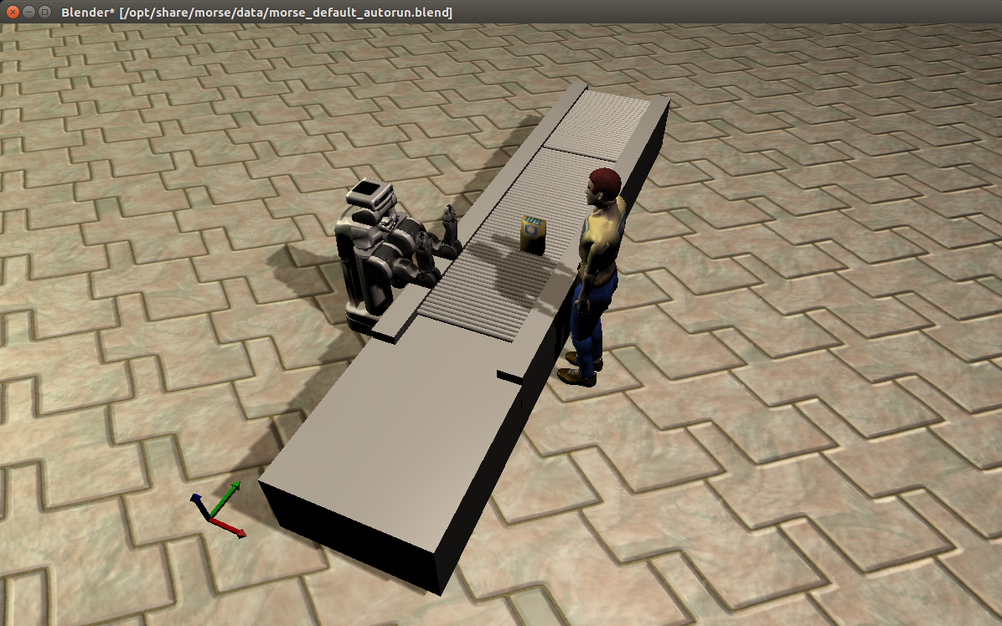
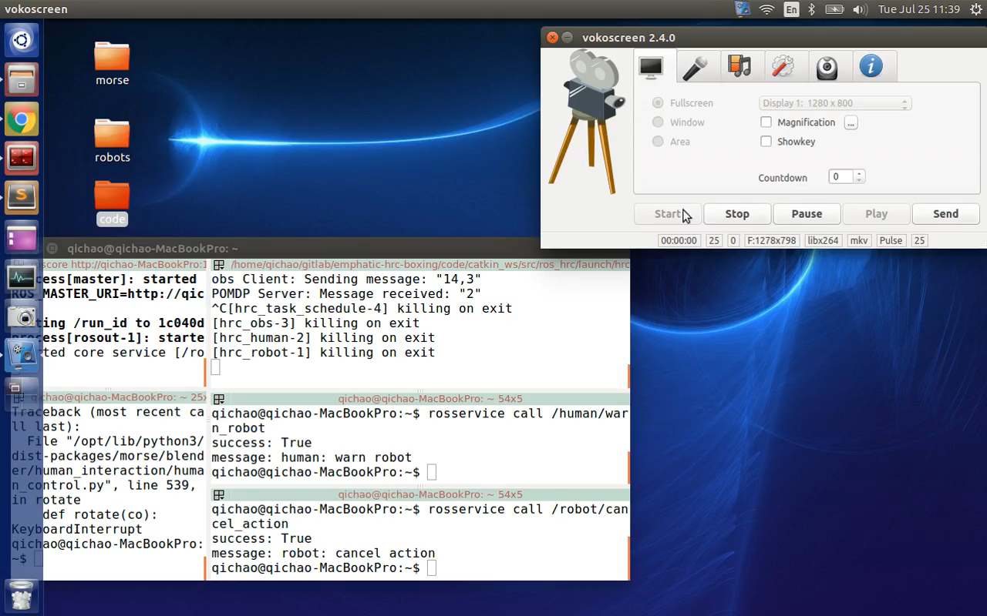
DEMO
1. Evaluating Human
2. Tired Human

Slide 17
Thank you for your interest!

Slide 18
Challenges
Poor documentation of MORSE for simulating our Human and Robot
Overwriting MORSE functions and overlaying ROS services for MORSE
Not enough resource for writing model for MDP and running it with no Belief interfere
SPARK for observation
Problems in installation (no support for MORSE)
Workaround with binary overview for observations
Integration
Adding web sockets
No available ROS package for our models (POMDP/MDP)
Synchronisation problem
Two independent models and difficulties in adding interruptions in between actions

